Slide 1
How To Succeed
In ENGL 110

Slide 2

Step One
Do the readings!!!

Slide 3
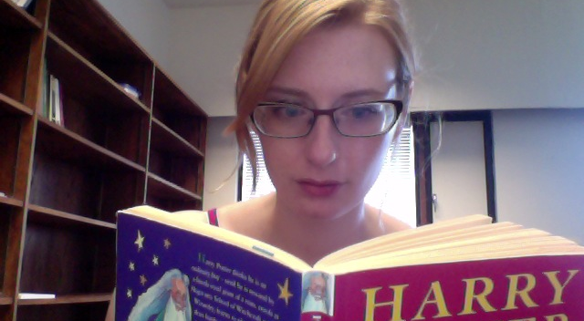
Step Two
Seriously, read the books!

Slide 4
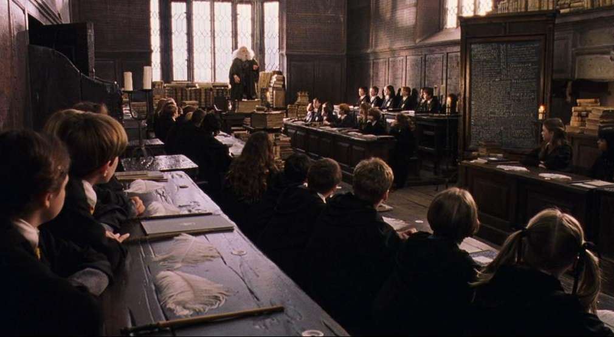
Step Three: Come to Class

Slide 5

Step Four: Pay Attention!
Don’t do this!
 ➔

Slide 6
Did You Know?
Multitasking impairs memory, causing up to an 11 percent decrease in a student’s grade
Seeing someone else multitask impairs a person’s memory, also resulting in a decreased grade. (Sana and Weston 2013)

Slide 7

Step Five: Take Notes!

Slide 8
Did You Know?
Taking notes not only helps you remember material, but helps you better understand it!
Taking notes by hand is more helpful than using a computer: students grades dropped by 17% when using a computer to take notes (Mueller and Oppenheimer 2014; Sana and Weston 2013).

Slide 9

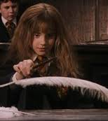
Step Six: Participate!

Slide 10
Participation
If I ask the class a question, I want someone to answer it!
You don’t even need to put up your hand!
If you have a question, ask it. Other people are probably wondering the same thing.
If you are given a group activity, do it! It will help you understand the concept better.

Slide 11
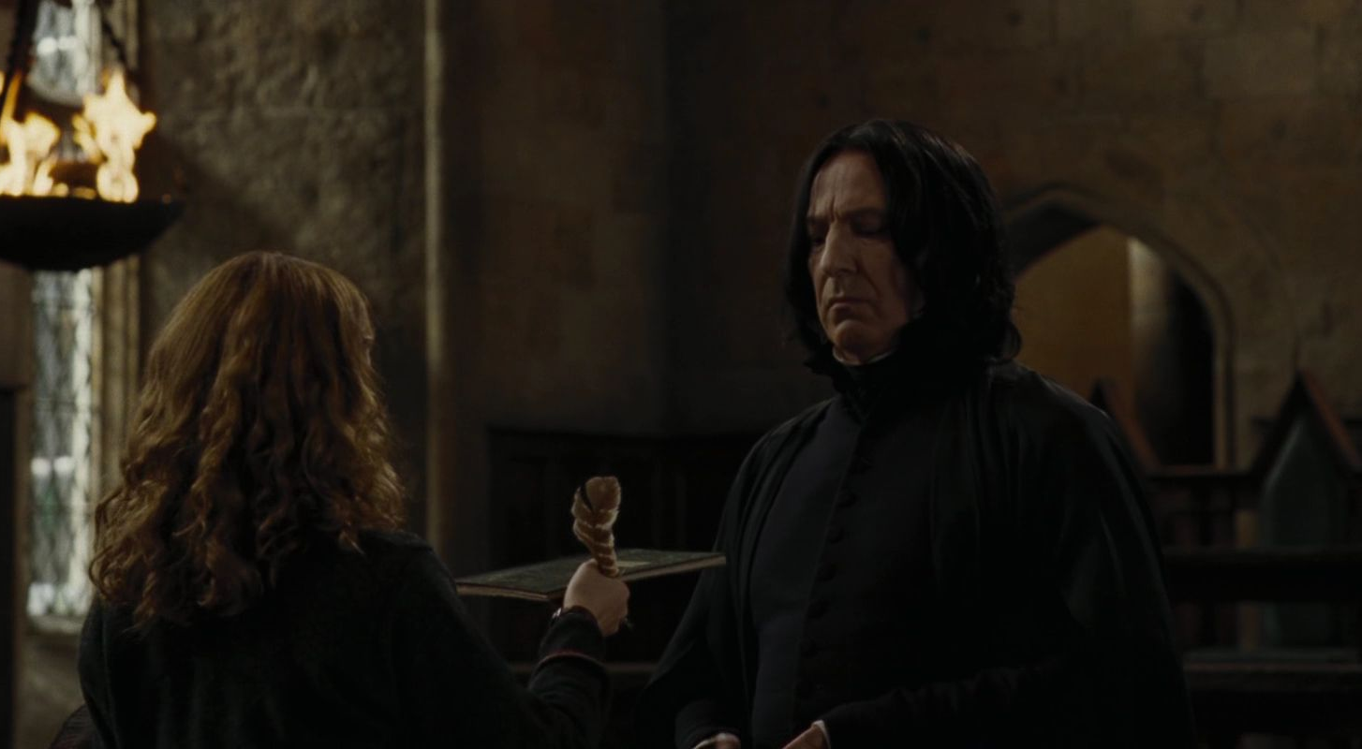
Step Seven: Hand Things In!

Slide 12
Hand Things In
All take-home assignments are required elements of the course, meaning if you do not hand one in, you automatically fail the course!
Also, hand things in on time: you lose 5% off your mark for everyday your paper is late.

Slide 13

Step Eight: Follow the Directions
I must tell you that this year, the third floor
corridor on the right-hand side is out of bounds
to everyone who does not wish to die a very
painful death.

Slide 14
Why is this so hard?
Read all directions for assignments carefully!
If you were asked to do something different in high school or another class, don’t do that!
You will lose lots of marks if you don’t follow the directions.

Slide 15
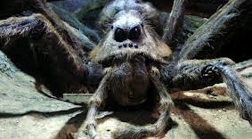
Step Nine: Don’t Cheat!
All cheaters will be fed
to Aragog’s children!

Slide 16
Why Not?
Penalties for academic misconduct are severe, ranging from a grade of zero on an assignment to a grade of zero in the class to expulsion from the university.
You cannot redo an assignment on which you were caught cheating.
If you just get a bad mark, you can rewrite that assignment.
It goes on your permanent record!

Slide 17
Step Ten: Get Help!

Slide 18
Get Help!
If you are struggling, ask for help!
Ask for help early on in the course.
Don’t wait until the last week of class to get help you’ve needed all along.

Slide 19
Step Eleven: Think for Yourself!

Slide 20
Brainy is the New Sexy
You don’t have to agree with my analysis!
You can have your own analysis!
I want you to have your own analysis and ideas!

